Slide 1
Analysis of New York Times Articles using Apache Hadoop, Mahout
Vamshi Krishna N S
(vamshins@unm.edu)

Slide 2
Introduction
The goal is to cluster the abstracts of some articles (approximately 40000) from the New York Times newspaper.
Clustering is done based on the tfidf scores.

Slide 3

So, what is tfidf?
term frequency–inverse document frequency (tfidf), is a numerical statistic that is intended to reflect how important a word is to a document in a collection or corpus.
Calculated by multiplying (Term Frequency) & (Inverse Document Frequency)

Slide 4


TF & IDF
TF(t) = (Number of times term t appears in a document) / (Total number of terms in the document).
IDF(t) = log(Total number of documents / Number of documents with term t in it)

Slide 5
Part 1: Data acquisition
Downloaded articles related to NewswireAPI from NY Times using API available at “http://developer.nytimes.com” and JAX-RS (Jersey 1.x ) Client API.
Articles are downloaded in JSON format.
Handled the code to eliminate the duplicate articles.
Parsed the JSON content using Java API for JSON Processing and stored all the articles in one single file in the following format
Doc_id | URL | Abstract
Sample

Slide 6

Part 2: Preprocessing, tf-idf
For this I have used Apache Hadoop Framework.
I have taken 3 MR Jobs:
MR1: Word Count in all the documents.
MR2: Calculate “tf” for the words in all documents.
MR3: Calculate “idf” and “tf-idf” for the words in all documents.

Slide 7
MR1 : Count Word Count in all Documents
Steps:
Remove all punctuation and numbers, and keep only the words.
REGEX_FOR_ALPHA = “[^a-zA-Z ]”
Convert each word to lowercase, remove stopwords.
Perform stemming.
MR Input: Document with all the news articles
Doc_id | URL | Abstract
MR Output: Word Count of all the words
Word@URL Count

Slide 8
MR2 : Calculate “tf” for the words in all documents
MR Input: output of MR1
Word@URL Count
MR Output: Term Frequency of all the words
Word@URL Term_Frequency

Slide 9
MR3: Calculate “idf” and “tf-idf” for the words in all documents.
MR Input: output of MR2
Word@URL Term_Frequency
MR Output: Term Frequency of all the words
Word@URL tf-idf

Slide 10
Part 3: Clustering
Used k-means algorithm to perform the clustering.
Select K initial centroids
Repeat
For each point, find its closes centroid and assign that point to the centroid. This results in the formation of K clusters
Recompute centroid for each cluster until the centroids do not change

Slide 11
K-means Clustering
Pros
Simple
Fast for low dimensional data
It can find pure sub clusters if large number of clusters is specified
Cons
K-Means cannot handle non-globular data of different sizes and densities
K-Means will not identify outliers
K-Means is restricted to data which has the notion of a center (centroid)

Slide 12

Used Apache Mahout to perform k-means clustering for the vector space produced by tfidf.
Ran k-means with 20 clusters.

Slide 13
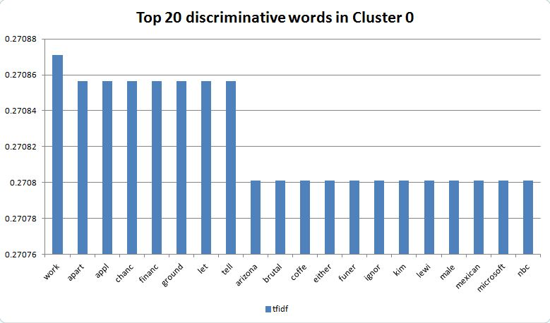
Visualization of clusters

Slide 14
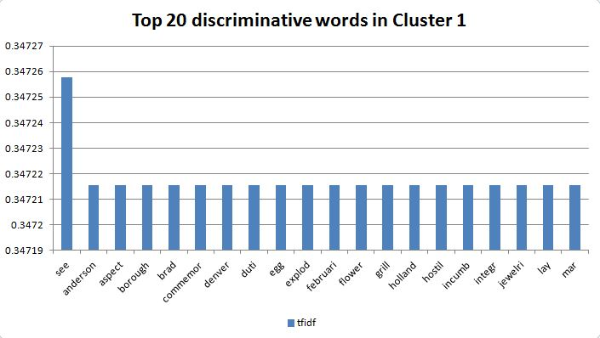

Slide 15
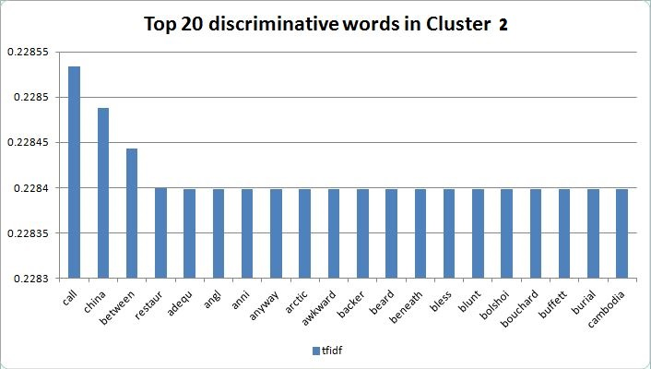

Slide 16
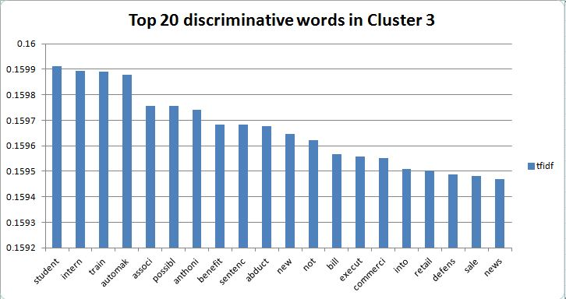

Slide 17
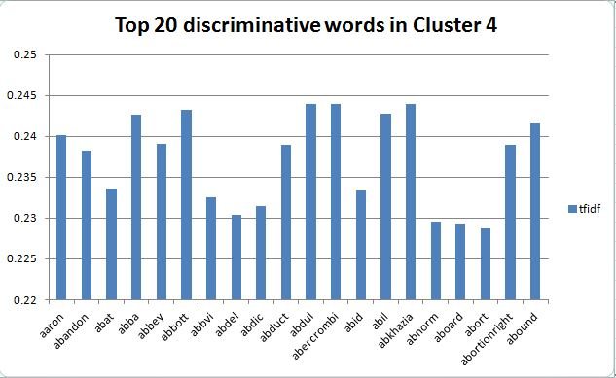

Slide 18
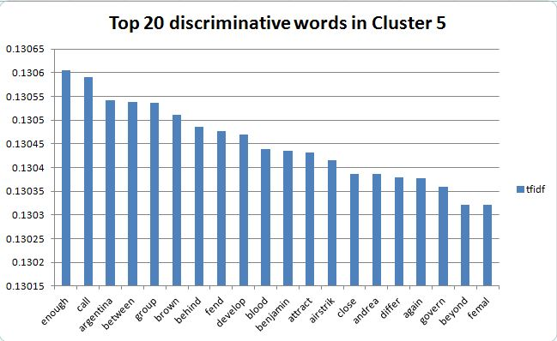

Slide 19
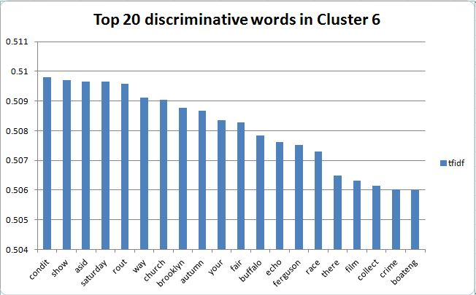

Slide 20
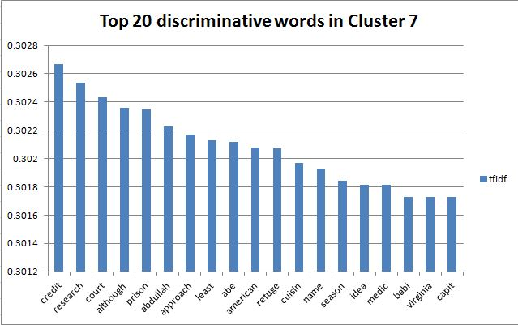

Slide 21
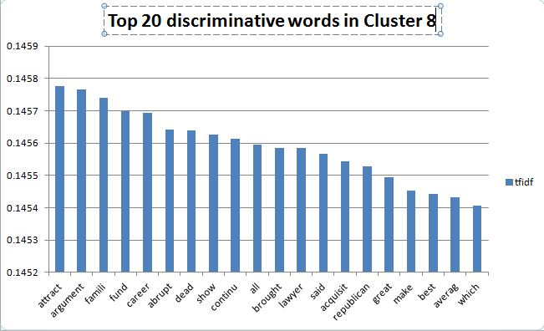

Slide 22
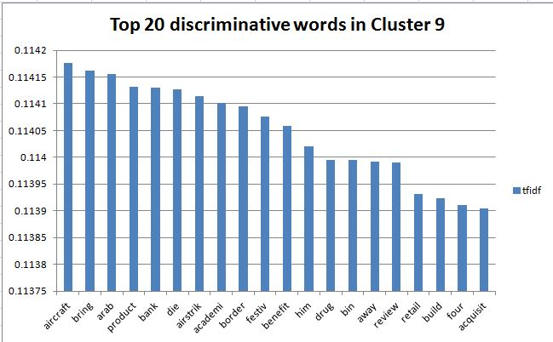

Slide 23
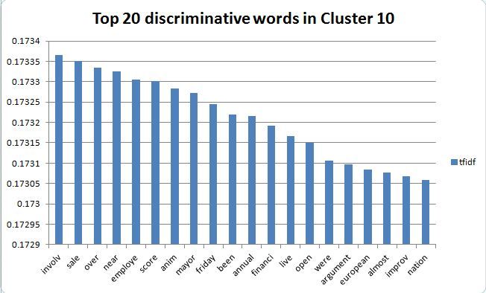

Slide 24
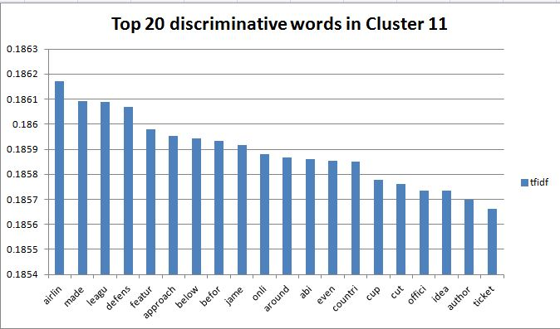

Slide 25
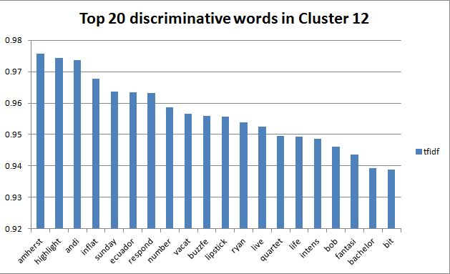

Slide 26
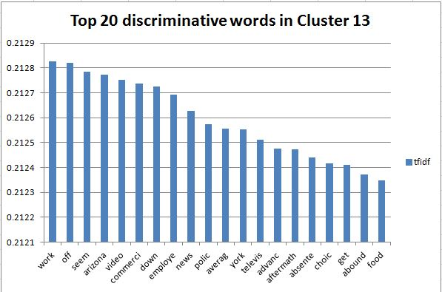

Slide 27
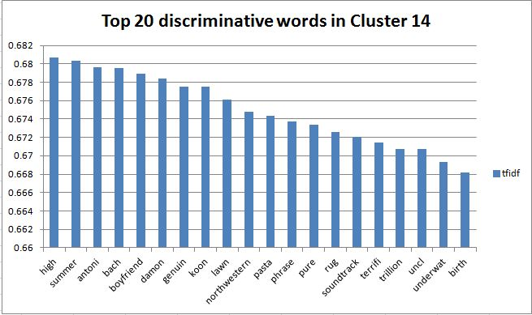

Slide 28
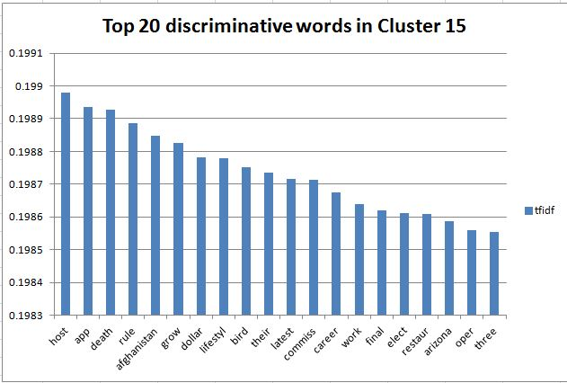

Slide 29
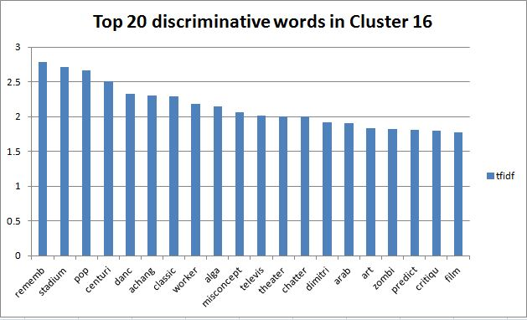

Slide 30
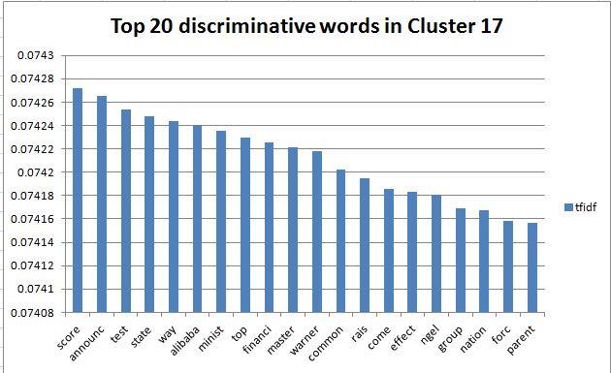

Slide 31
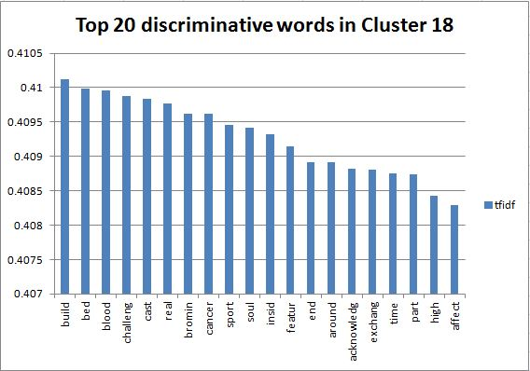

Slide 32
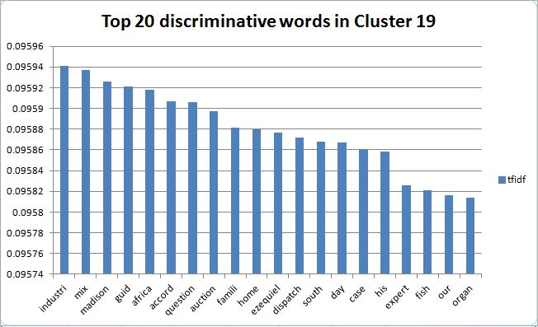

Slide 33
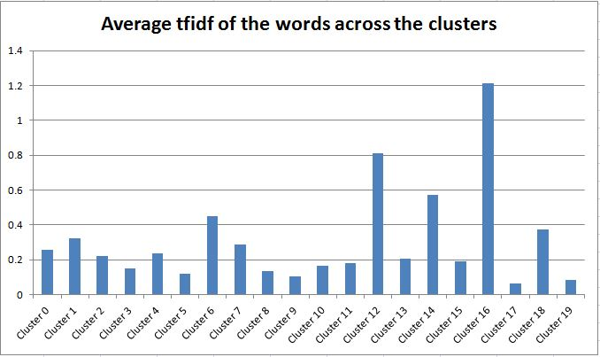

Slide 34
Average tfidf across all the clusters

Slide 35
THANK YOU

